Slide 1
REGRESSION

Slide 2
Perhaps the most common goal in statistics is to answer the question “Is the variable
X (or more likely, X1, ..., Xp) associated with a variable Y, and if so, what is the relationship
and can we use it to predict Y?

Slide 3
The prediction of an outcome (target) variable based on the values of other “predictor” variables.
This process of training a model on data where the outcome is known, for subsequent application to data where the outcome is not known, is termed Supervised learning.
Another important connection between data science and statistics is in the area of anomaly detection, where regression diagnostics originally intended for data analysis and improving the regression model can be used to detect unusual records.

Slide 4
Simple Linear Regression
Simple linear regression provides a model of the relationship between the magnitude of one variable and that of a second—for example, as X increases, Y also increases. Or as X increases, Y decreases.
Correlation is another way to measure how two variables are related
The difference is that while correlation
measures the strength of an association between two variables, regression
quantifies the nature of the relationship.

Slide 5
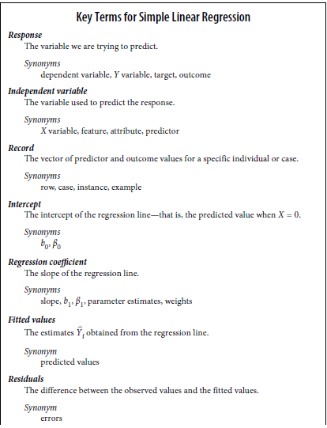

Slide 6

The Regression Equation
Simple linear regression estimates how much Y will change when X changes by a certain amount. With the correlation coefficient, the variables X and Y are interchangeable.
With regression, we are trying to predict the Y variable from X using a
linear relationship (i.e., a line):

Slide 7
We read this as “Y equals b1 times X, plus a constant b0.”
The symbol b0 is known as the intercept (or constant), and the symbol b1 as the slope for X.
The Y variable is known as the response or dependent variable since it depends on X.
The X variable is known as the predictor or independent variable.
The machine learning community tends to use other terms, calling Y the target and X a feature vector.

Slide 8
Implementation of Simple Linear Regression Algorithm using Python
Problem Statement example for Simple Linear Regression:
Here we are taking a dataset that has two variables: salary (dependent variable) and experience (Independent variable). The goals of this problem is:
We want to find out if there is any correlation between these two variables
We will find the best fit line for the dataset.
How the dependent variable is changing by changing the independent variable.

Slide 9
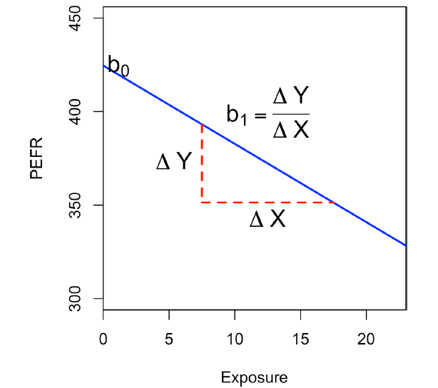

Slide 10



Fitted Values and Residuals:
Important concepts in regression analysis are the fitted values (the redictions) and residuals (prediction errors). In general, the data doesn’t fall exactly on a line, so the regression equation should include an explicit error term ei:
The fitted values, also referred to as the predicted values, are typically denoted by Yi (Y-hat). These are given by:
We compute the residuals ei by subtracting the predicted values from the original data:

Slide 11
fitted = regressor.predict(lung[predictors])
residuals = lung[outcome] - fitted

Slide 12
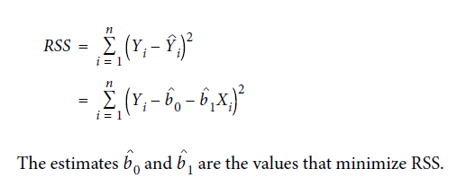
Least Squares
the regression line is the estimate that minimizes the sum of squared residual values, also called the residual sum of squares or RSS:
The method of minimizing the sum of the squared residuals is termed least squares
regression, or ordinary least squares (OLS) regression.

Slide 13
Prediction Versus Explanation (Profiling):
With the advent of big data, regression is widely used to form a model to predict individual outcomes for new data (i.e., a predictive model) rather than explain data in hand. In this instance, the main items of interest are the fitted values Y. In marketing, regression can be used to predict the change in revenue in response to the size of an ad campaign. Universities use regression to predict students’ GPA based on their SAT scores.
A regression model that fits the data well is set up such that changes in X lead to changes in Y. However, by itself, the regression equation does not prove the direction
of causation.
Conclusions about causation must come from a broader understanding about the relationship. For example, a egression equation might show a definite relationship between number of clicks on a web ad and number of conversions. It is our knowledge of the marketing process, not the regression equation, that leads us to the conclusion that clicks on the ad lead to sales, and not vice versa.

Slide 14


Multiple Linear Regression
When there are multiple predictors, the equation is simply extended to accommodate them:
All of the other concepts in simple linear regression, such as fitting by least squares and the definition of fitted values and residuals, extend to the multiple linear regression setting.
For example, the fitted values are given by:

Slide 15
